Slide 1



Data Analysis Project
A comprehensive exploratory data analysis project deployed using AWS

Slide 2
Project Overview
Project Objective This project conducts a comprehensive Exploratory Data Analysis (EDA) on Airbnb's 2019 dataset to uncover meaningful insights. The analysis process is structured into the following stages:
Data Acquisition
Extracted data securely from AWS RDS using optimized SQL queries.
Data Cleaning & Preprocessing
Addressed missing values, removed duplicates, and handled outliers to ensure data integrity.
Visualization of Insights
Generated actionable insights through advanced visualizations created with Matplotlib and Plotly.
Interactive Web Deployment
Delivered findings via an interactive Flask-powered web application, hosted on AWS EC2 for accessibility and scalability.

Slide 3
Data Source
Contains 48,895 rows and 16 columns detailing Airbnb listings in New York City from 2019.
Key information includes host details, neighborhood, room type, price, and availability.
Stored in an Amazon RDS instance for efficient access and analysis.

Slide 4
Workflow Overview
1. Data Fetching: Accessed via SQL query from RDS.
2. Data Cleaning: Handled outliers, missing values, and duplicate records.
3. Visualization: Generated insightful plots using Matplotlib and Plotly.
4. Deployment: Deployed visualizations using Flask and AWS EC2.

Slide 5
Data Fetching
Connect to the RDS instance and query data.
Process:
Configured AWS RDS for secure data storage.
Accessed Airbnb data using SQL queries with Python's SQLAlchemy library.
Imported the data into Pandas DataFrame for further analysis.

Slide 6
Data Cleaning Process
- Removed duplicates using unique Airbnb IDs.
- Filtered outliers in price and availability columns using IQR.
- Restricted valid ranges for latitude, longitude, and minimum nights.
- Standardized string columns for better readability.

Slide 7
Data Visualization
Objective: Generate meaningful insights through visual representations.
Process:
Used Matplotlib and Plotly for creating charts, such as scatter plots, box plots, and bar graphs.
Highlighted patterns, such as room type distribution and price variations.
Exported visualizations for embedding into the web interface.

Slide 8
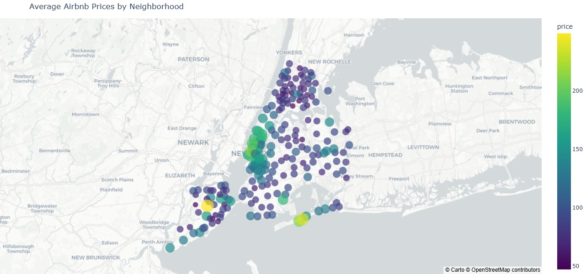
Average Airbnb Prices by Neighborhood
Manhattan has the highest average Airbnb prices, with premium rates concentrated in central neighborhoods.
Prices gradually decrease as listings move outward to boroughs like Brooklyn and Queens.

Slide 9
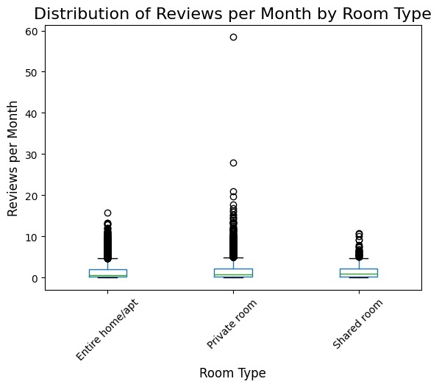
Distribution of Reviews per Month by Room Type
Private rooms have a slightly higher median review rate compared to other room types, indicating consistent popularity.
Entire homes/apartments and shared rooms exhibit fewer reviews, with some outliers showing exceptionally high activity.

Slide 10
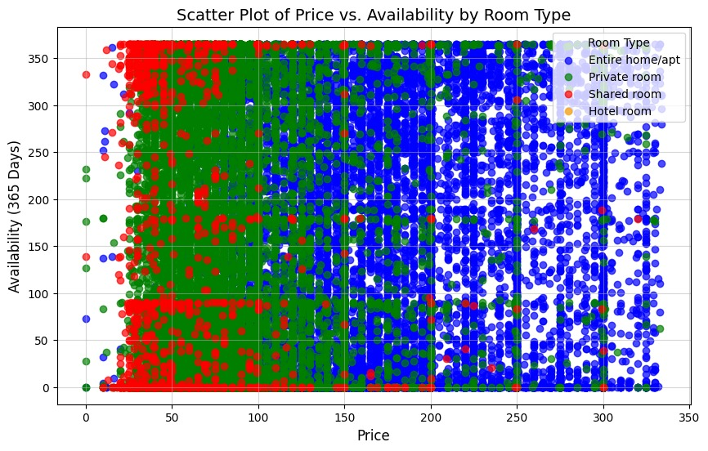
Scatter Plot of Price vs. Availability by Room Type
Entire homes/apartments are predominantly found at higher price points with variable availability.
Private and shared rooms show more affordable pricing and moderate to high availability throughout the year.

Slide 11
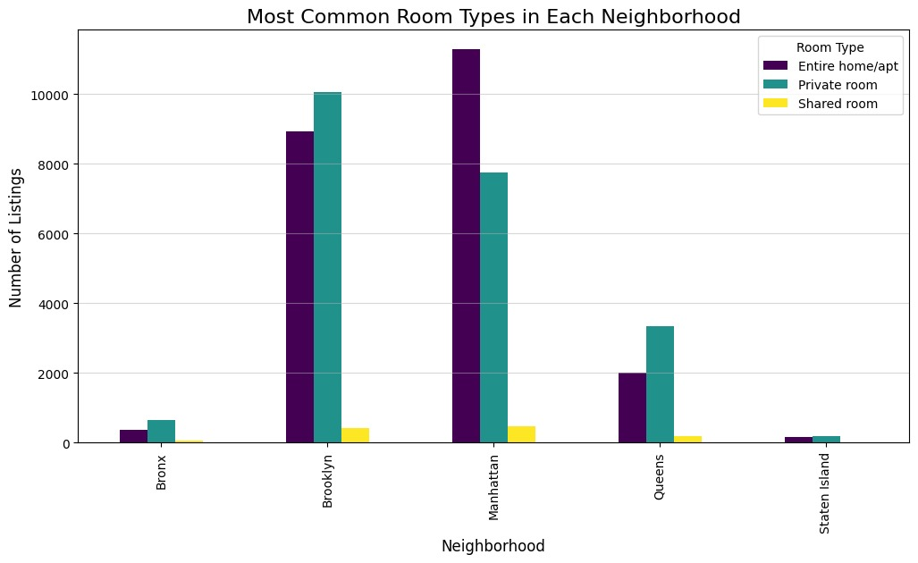
Most Common Room Types in Each Neighborhood
Brooklyn and Manhattan dominate with a high prevalence of entire homes/apartments and private rooms.
Shared rooms are significantly fewer in number, reflecting lower demand or supply in all boroughs.

Slide 12
Deployment
Make the analysis interactive and accessible via a web platform.
Process:
Integrated Flask backend with HTML/CSS/JavaScript for an interactive UI.
Hosted the web application on AWS EC2 for global access.
Enabled navigation through visualizations with responsive controls.

Slide 13
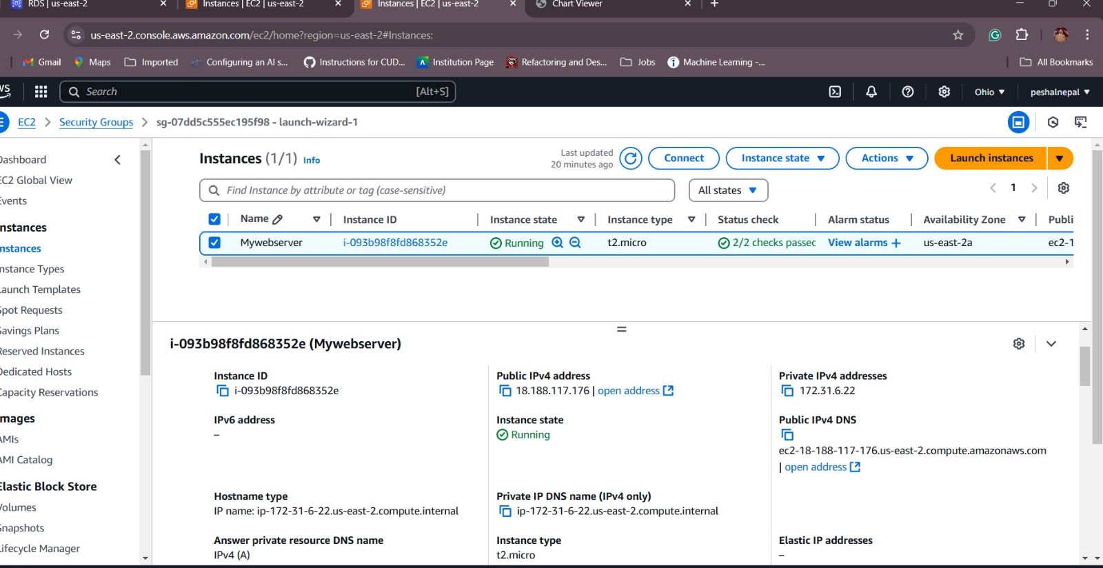
AWS EC2 Instance Configuration for Web Deployment
This image shows an active AWS EC2 instance named Mywebserver, configured for hosting and connected to an RDS database. The instance is running in the us-east-2a availability zone with an instance type of t2.micro, suitable for lightweight applications.
It includes a Public IPv4 address (18.188.117.176) for external access and a Private IPv4 address (172.31.6.22) for secure internal communication. The instance has passed status checks, ensuring operational reliability and readiness for deployment.

Slide 14
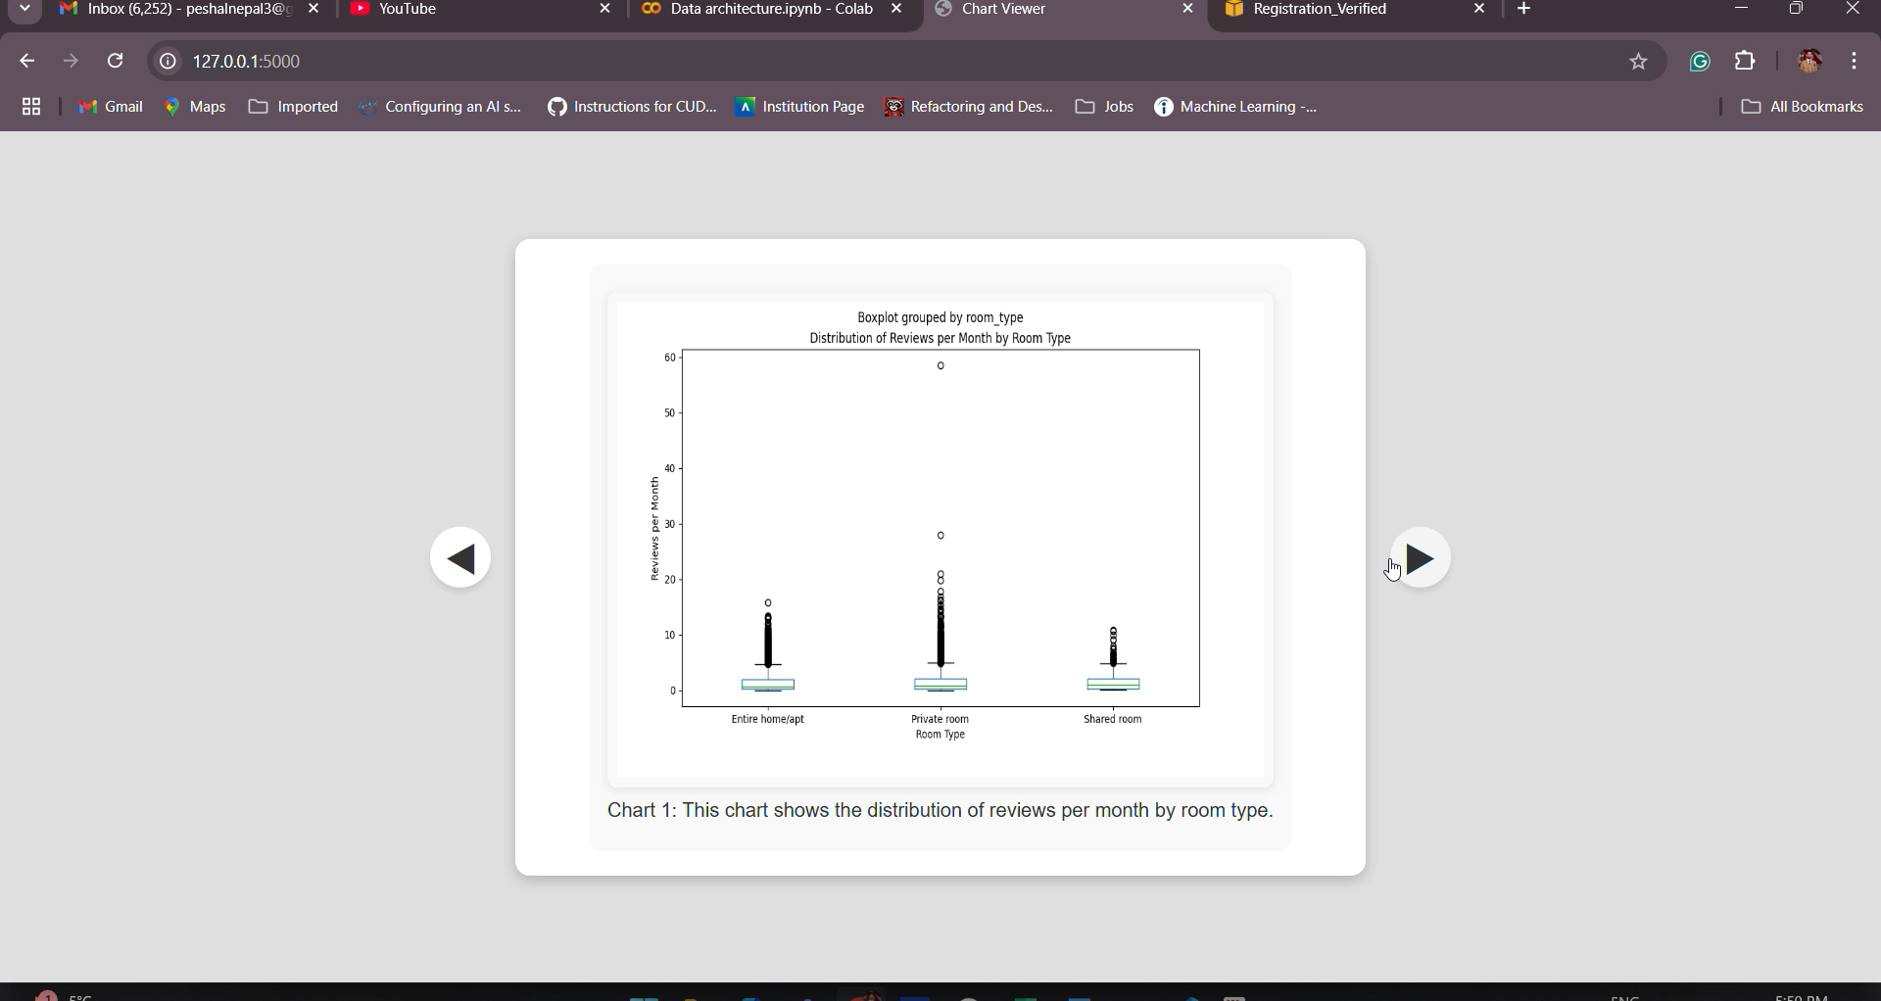
Final Integrated Visualization
The integrated visualization showcases an interactive display of charts.

Slide 15
Challenges and Learnings
Handling missing values and outliers during data cleaning.
01
Integrating multiple interactive charts into a cohesive visualization.
02
Ensuring accurate and meaningful insights from complex data.
03

Slide 16
Conclusion
The project effectively leveraged AWS and Python to perform comprehensive exploratory data analysis, uncovering key insights into Airbnb pricing, availability, and room type trends across New York City.
An interactive visualization platform was deployed using Flask, making the analysis accessible and user-friendly while addressing challenges like data cleaning and outlier management.

Slide 17

Thank You

